Slide 1

Longevity Specialty Finance, llc
LSF’s Competitive Advantage

Slide 2
Longevity Specialty Finance
“Setting new standards for valuing level-3 assets and liabilities”
LSF has the exclusive commercial rights to the Longevity Cost Calculator (LCC), a proven longevity predictive machine learning algorithm-based tool.
LSF has a team of veteran financial professionals who have originated and managed L-3 portfolios of more than $9.5 billion of securitized insurance death benefits, reverse mortgages, pension assets.
LSF’s Longevity Cost Calculator (LCC), that allows us to accurately price and value assets with unknowable future maturity.
LCC accuracy allows LSF to predict future portfolio cash flows in a GAAP/SEC compliant methodology leading to higher portfolio valuations.

Slide 3

Longevity Cost Calculator
The LCC LE is based on 76 questions developed for the NLTCS in 1980s.
The model originator, Eric Stallard at Duke, was the actuary and demographer on the interdisciplinary team that spent a year developing the questions.
20,000 individuals ages 65-69 were consecutively assessed every 5 years for 4 consecutive assessments (20-years of progressive data).
Data integrity was closely managed to yield ‘clean data’
Stallard spent 10-years developing and validating the machine learning algorithms to evaluate the 30+ million co-dependent variables.
The predictive value of the LCC comes from correlating patterns in co-dependent variables gathered consecutively over 20-years on the same individuals.
2007 the model was peer reviewed and published.

Slide 4
Longevity Cost Calculator
2009 Mazonas analyzed Stallard published papers to diagram, write code and validated the PC based model.
Model was presented to the SEC in 2009 testimony.
2011 Mazonas, Stallard and Graham published the Bayesian Inference Level 3 valuation methodology at heart of SEC Rule 2a-5.
Three times since 2010 the model’s 96+% accuracy was been replicated. 2010,2014,2017.
“Grade of Membership”(GoM) classification methodology used to calibrate responses.
Each LCC assessment completed in 10-minute telephone interview.
Immediate model output is individual’s survival function curve and other scores

Slide 5
Key Predictor:
Grade of Membership (GoM) Scoring
The LCC question set generates 30 million co-dependent variables that need to be classified. This gave rise to the GoM classification system. An individual’s total GoM score adds up to 1.0. Individuals usually have “attributes” of all 4 classifications. Occasionally the model experiences a “Pure Type” individual who is 1.0 in a single classification.
GoM I – Generally healthy with lowest level of impairments
GoM II – Poorest subjective health, largest number of medical conditions,
non-institutionalized, strong ADLs & Cognition, low mortality
GoM III – High mortality rates, few medical conditions, few impairments
relatively good subjective health, poor ADLs & Cognition
GoM IV – High mortality rates, high levels of physical and cognitive disability and institutionalization

Slide 6
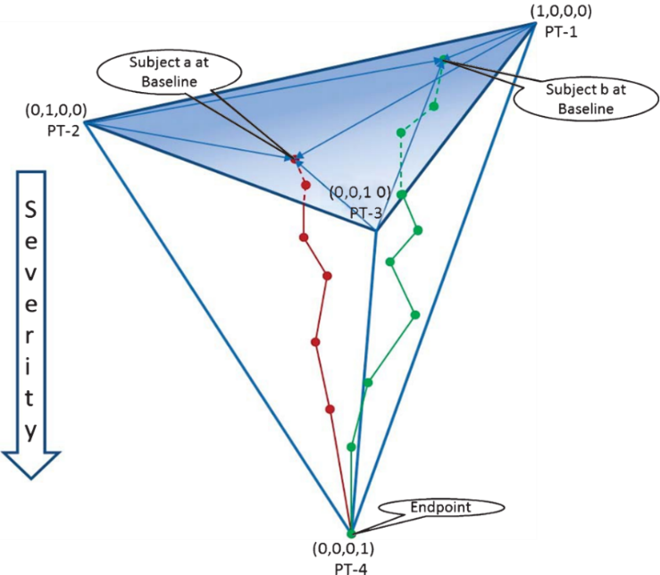
Key Predictor:
Grade of Membership (GoM) Scoring
Multiple Assessments Matter
Single Assessment – Point
Two Assessments – line
Three Assessments - Trajectory
GoM 2
GoM 3 & 4

Slide 7
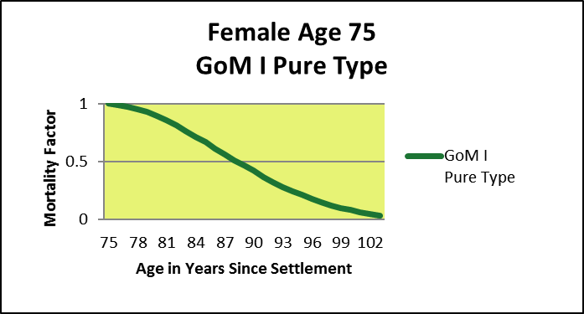
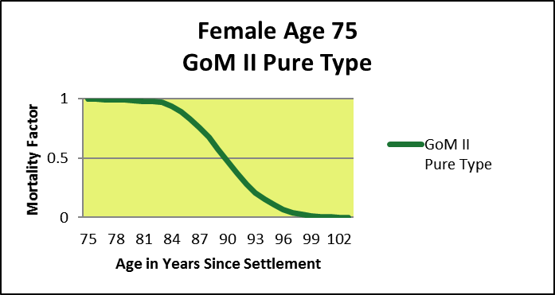
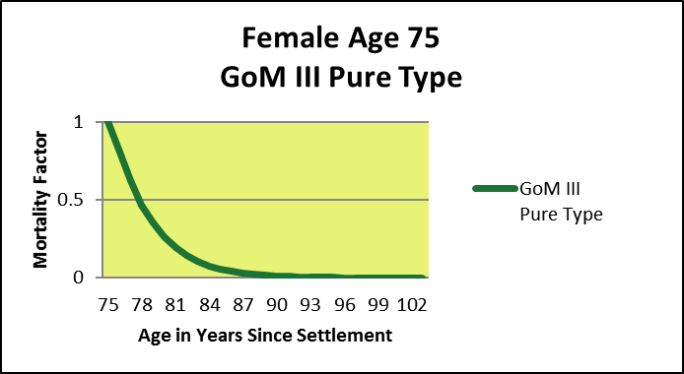

Grade of Membership (GoM) Scoring
Relative GoM I through GoM IV Pure Type Survival Functions

Slide 9
Usual LE Range by Medical LEs
Probable LCC LE Range

Slide 10
LCC is Key to GAAP Mark-to-Fair Value Methodology
LCC GAAP compliant valuation methodology presented to SEC in 2009
SEC Rule 2a-5 requires valuation by NPV of predictable cash flows
Paper quoted more than 75 times in technical papers
  Methodology simple and uses 300 year-old Bayesian Inference math to support hypothesis that LCC is better predictor of LE than other methods
  When consistently applied in portfolio valuation allows use of lower discount rate to NPV future portfolio cash flows – the measure of portfolio value
  Adds accretive incremental P&L book income and cumulative B/S asset value

Slide 11
$160 Million L-3 Portfolio
Mark-to-Fair Value vs Mark-to-Market Comparison
Policy Purchase Cost = $100 million
(Ascribes No Value to Initial $60 million Cash Reserves)
Discount Rate Applied
To Settlement Portfolio Balance Sheet Value
7.5% - Mark-to-Fair Value After $200 Million
Predictable Cash Flow
Demonstrated
11% - Portfolio Cost - Breakeven $100 Million
18.5% - Mark-to-Market if Can’t
Predict Cash Flows $ 65 Million

Slide 12
Contact Information
Peter M. Mazonas, CPA
Managing Member
Longevity Specialty Finance, llc
Peter.Mazonas@LSF-llc.com
Dir: (415) 924-6269
Cell: (415) 279-7950
http://www.LSF-llc.net
https://www.LSF-llc.com

